Slide 1

Team Details
Team Name: Team Anjroid
Team Leader Name: Achhuta Nand Jha
Problem Statement: Farmers need accurate and timely weather information to make informed decisions and optimize their agricultural practices.

Slide 2

Brief about the idea
The Farmer Weather App is designed to provide farmers with real-time, location-based weather information and forecasts. By offering accurate and timely weather updates, customizable alerts for severe conditions, and detailed metrics such as temperature, wind speed, humidity, and cloud coverage, the app aims to help farmers make informed decisions about their agricultural activities. This user-friendly and accessible tool integrates advanced weather APIs and location services to ensure farmers have the information they need to enhance their farming practices and improve crop yields.

Slide 3
Opportunities
How different is it from any of the other existing ideas?
Tailored Weather Updates: Provides weather information and forecasts specifically designed to address farming activities, such as planting, irrigation, and harvesting.
Customizable Alerts: Farmers receive alerts for severe weather conditions that could impact their crops, allowing them to take preventive measures.
Detailed Agricultural Metrics: In addition to standard weather metrics, the app includes information crucial for farming, such as soil moisture levels and optimal planting times.
Location-Based Precision: Uses advanced GPS and location services to provide hyper-local weather data, ensuring accuracy for specific farming areas.
User-Friendly Interface: Designed with farmers in mind, the app features a simple and intuitive interface that is easy to navigate, even for those with limited technical skills.
Integration with Farming Calendars: Syncs weather information with farming calendars to help farmers plan their activities more effectively.

Slide 4
Opportunities
How will it be able to solve the problem?
The Farmer Weather App provides real-time, accurate, and location-specific weather updates and forecasts, enabling farmers to make informed decisions about their agricultural activities. Customizable alerts for severe weather conditions help farmers protect their crops, while the user-friendly interface ensures easy access to essential weather metrics. By offering tailored weather information and actionable insights, the app optimizes farming practices and improves crop yields.

Slide 5
Opportunities
USP of the proposed solution
The Farmer Weather App uniquely caters to the specific needs of farmers by providing hyper-local, real-time weather updates and accurate forecasts. Its customizable alerts for severe weather conditions and detailed agricultural metrics, combined with a user-friendly interface, ensure that farmers can easily access and utilize critical weather information to optimize their farming practices and enhance crop yields.

Slide 6
List of features offered by the solution
Real-Time Weather Updates: Continuous and up-to-date weather information.
Location-Based Weather Information: Hyper-local data tailored to specific farming areas.
Accurate Weather Forecasts: Short-term and long-term forecasts for better planning.
Customizable Alerts: Notifications for severe weather conditions and critical changes.
Detailed Agricultural Metrics: Information on temperature, wind speed, humidity, soil moisture, and cloud coverage.
User-Friendly Interface: Intuitive design for easy navigation and access.

Slide 7
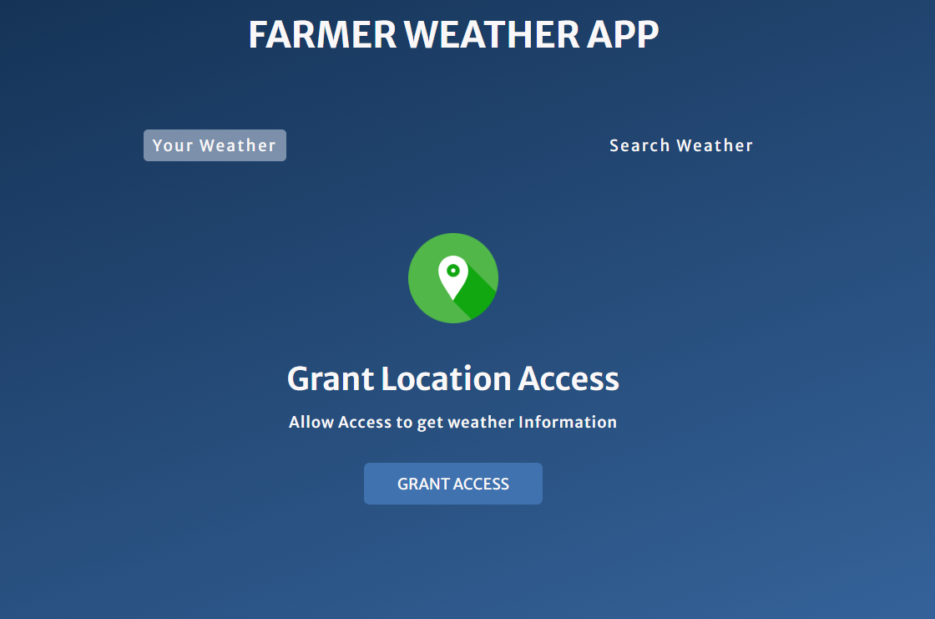
Process flow diagram or Use-case diagram

Slide 8
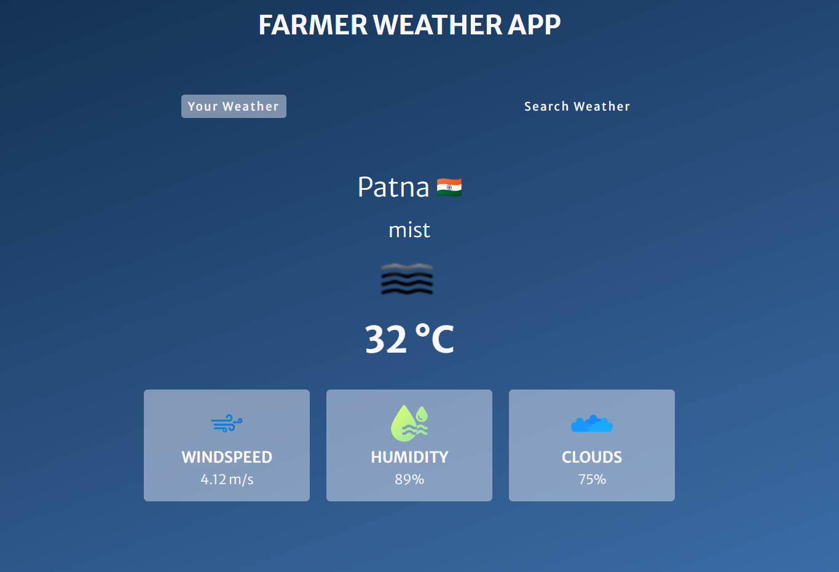
Wireframes/Mock diagrams of the proposed solution (optional)

Slide 9
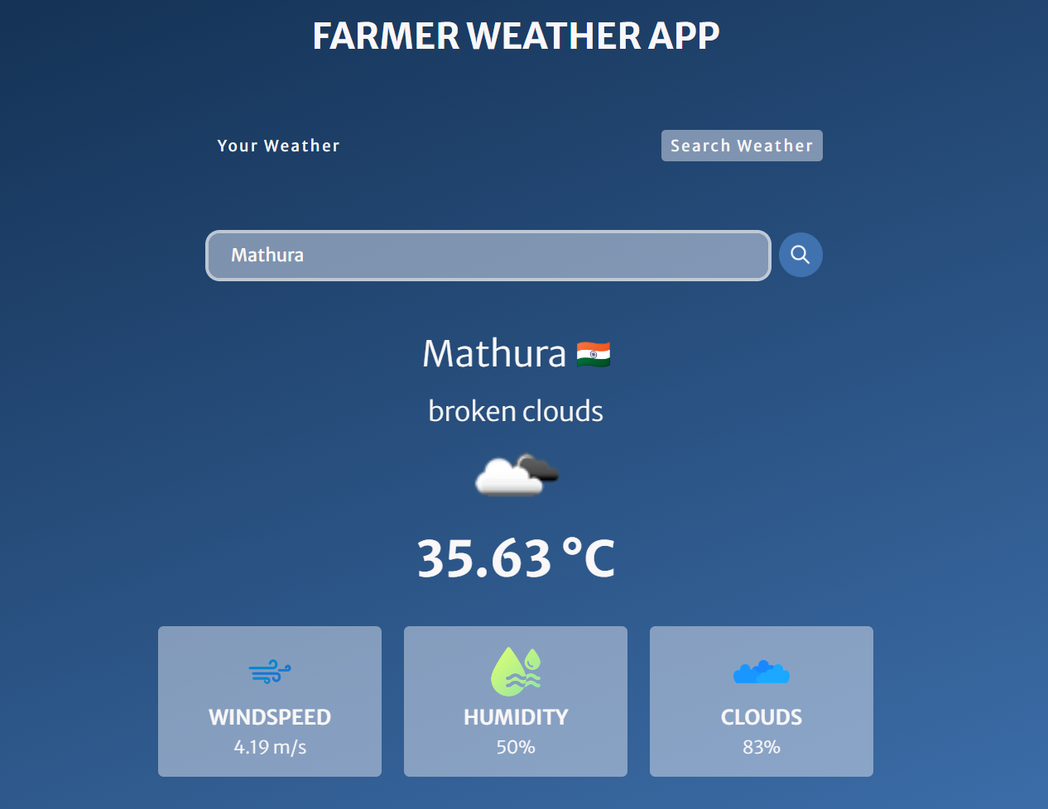
Architecture diagram of the proposed solution

Slide 10
Technologies to be used in the solution
HTML
CSS
JavaScript
Images

Slide 11
Estimated implementation cost (optional)
Development Time
HTML/CSS/JavaScript Coding: 2 hours = ₹60
Image Sourcing/Editing: 1 hours = ₹10
Testing and Debugging
Testing Time: 1 hour = ₹10
Miscellaneous
Other: ₹20
Total Estimated Cost: ₹100

Slide 12
Team Name: Team Anjroid
Team Members:
1. Achhuta Nand Jha
2. Nirjala kumari
3. Arjun Singh Rajput
4. VAIBHAV JAIN
Demo Link

Slide 13


